Slide 1

CO2 GAS FLOODING SYSTEM
CNG COMPRESSURE AREA ON FEELING STATION

Slide 2

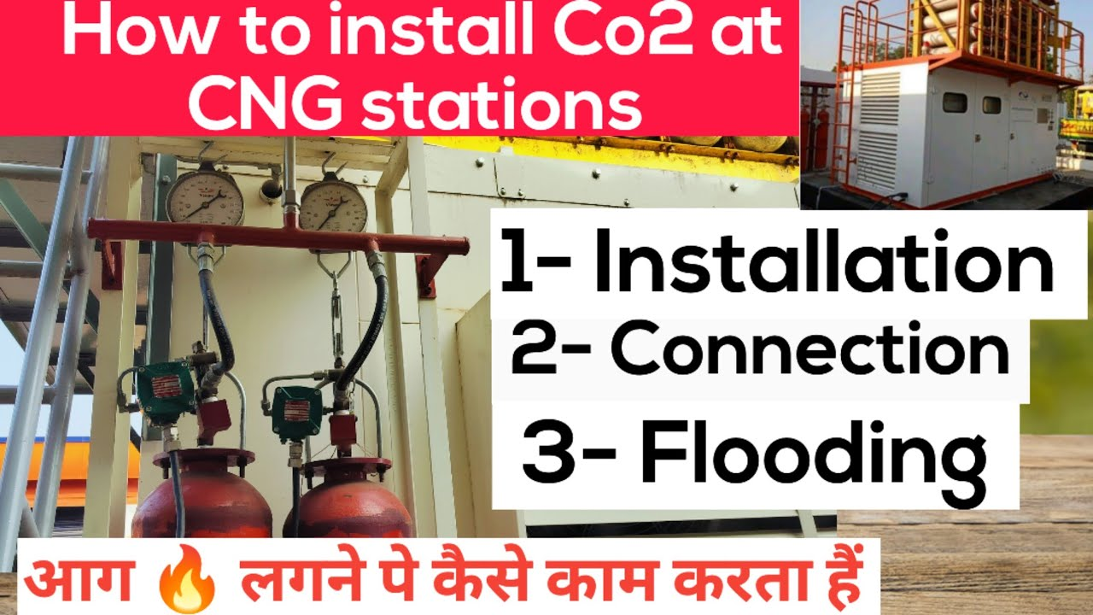
Designer helps you get your point across
technical write-up for a CO₂ flooding system designed for a CNG (Compressed Natural Gas) Compressor Area:
1. Purpose & Scope
The Carbon Dioxide (CO₂) flooding system is a total flooding fire suppression solution specifically engineered for CNG compressor areas, where the risk of fire due to flammable gas leakage, high pressure, and hot mechanical components is significant. The system is designed to quickly suppress Class B (flammable gases) and Class C (electrical) fires, minimizing damage and downtime while ensuring safety in hazardous environments.

Slide 3
Designer helps you get your point across
technical write-up for a CO₂ flooding system designed for a CNG (Compressed Natural Gas) Compressor Area:
2. Why CO₂ for CNG Compressor Fire Protection?
Non-conductive – Safe around electrical and control systems.
No residue – No cleanup required after discharge.
Fast-acting – Rapid knockdown of fire by displacing oxygen.
Penetration – Can reach enclosed and complex spaces in compressor skids.

Slide 4
Designer helps you get your point across
3. System Design Approach
🔧 A. Detection and Activation
Fire detection via:
Heat detectors (rate-of-rise or fixed temperature)
Flame detectors (for fast flame recognition)
Gas detectors (optional, for pre-alarm methane leakage)
Activation modes:
Manual pull station (emergency)
Automatic release via detection system
Optional delay and alarm to allow evacuation (usually 30–60 seconds)

Slide 5
Designer helps you get your point across
B. Suppression Agent – CO₂
High-pressure or low-pressure CO₂ storage cylinders
Stored in cylinder bank located in a safe zone
CO₂ released through a piping network with nozzles directed into:
Compressor enclosure
Electrical panels (if integrated)
Acoustic hood (if present)

Slide 6
Designer helps you get your point across
C. Discharge Mechanism
Total flooding design:
CO₂ is discharged into the entire protected volume to achieve a concentration that displaces oxygen and suppresses combustion.
Typical design concentration: 34–75% CO₂ by volume, based on hazard type and enclosure volume.
Discharge duration:
Rapid discharge within 60 seconds for full concentration
Post-discharge, system holds concentration for 10–20 minutes to prevent re-ignition

Slide 7
Designer helps you get your point across
4. System Components
CO₂ Cylinders with valves and siphon tubes
Main distribution manifold
Actuation devices (manual, pneumatic, or electric)
Discharge nozzles with deflectors
Flame/heat/gas detectors and control panel
Warning alarms and strobes (pre-discharge alert)
Pressure switches, solenoids, and time delay relays
Ventilation interlock (shuts down HVAC upon activation)
Safety signage and emergency stop

Slide 8
Designer helps you get your point across
5. Safety Measures
Pre-discharge alarms: Audible and visual alarms warn personnel to evacuate.
Time delay: Typically 20–60 seconds before CO₂ release.
Lockout/tagout stations to prevent accidental activation during maintenance.
Post-discharge ventilation system for safe re-entry after CO₂ evacuation.
Compliance with NFPA 12, OISD, and local fire codes.

Slide 9
Designer helps you get your point across
6. System Advantages
Effective for flammable gas environments
No water or chemical residue
Ideal for unmanned or restricted-access areas
Can be integrated with plant DCS/SCADA systems

Slide 10
Designer helps you get your point across
7. Maintenance & Inspection
Monthly visual inspection of cylinders and control panel
Semi-annual testing of detectors and alarms
Annual full system function test (as per NFPA 12 guidelines)
Hydrostatic testing of cylinders as per statutory requirements

Slide 11
Designer helps you get your point across
8. Conclusion
The CO₂ flooding system provides an effective and reliable solution for protecting critical CNG compressor areas from fire hazards. With its ability to suppress fires rapidly and without damaging equipment, it plays a vital role in maintaining the safety and operational continuity of natural gas compression facilities.

Slide 12
FIRE ENGINEERING TECHNOLOGY
Thanks and Regards
ANIL MISHRA (9971365130)
HTTPS://WWW.FIREENGINEERINGTECHNOLOGY.COM
FIRE ENGINEERING TECHNOLOGY
(AN ISO 9001:2015 Certified Company)
Regt. Address :H N 227 -228/9, Prashant Enclave, Baprola, Najafgarh, New Delhi-110043Correspondence Address : Plot No. 71, Sewak Park, Dwarka More Metro Station, Near Pillar No. 776, Uttam Nagar, New Delhi-110059, Delhi, India
Manufacturing Unit 1: PLOT NO - 4 LAXMI VIHAR, PART-3 NAJAFGARHNEW DELHI - 110043
Manufacturing Unit 2 : Plot No. 1, Nangali Sakarawati, Najafgarh-110043

